Slide 1
Eurex 10yr Spanish Euro-Bono Futures
August 2020

Slide 2
Agenda
Background
10y Spanish Euro-Bono Futures (FBON)
Eurex Euro-Bono Futures: Contract specifications
Opportunities in Trading and Clearing
Wholesale Offering
Further Information and Contacts
Appendices

Slide 3
Background
From the beginning of the European sovereign crisis till recently Spanish and Italian government bond yields were closely correlated (please see next slide).
Therefore Euro-BTP Futures were considered a good proxy hedging instrument for Spanish government bond portfolios.
However, starting from 2016 a variety of factors created a divergence between Spanish and Italian government bond yields raising the prospect of the BTP Futures no longer being an appropriate hedge for Spanish government bonds.
Market participants stated that up to 30% of their Euro-BTP Futures trades are hedges for positions on Spanish government bonds. Therefore, for accuracy in the current interest rate environment, they prefer to use a dedicated futures instrument to avoid the basis risk.

Slide 4
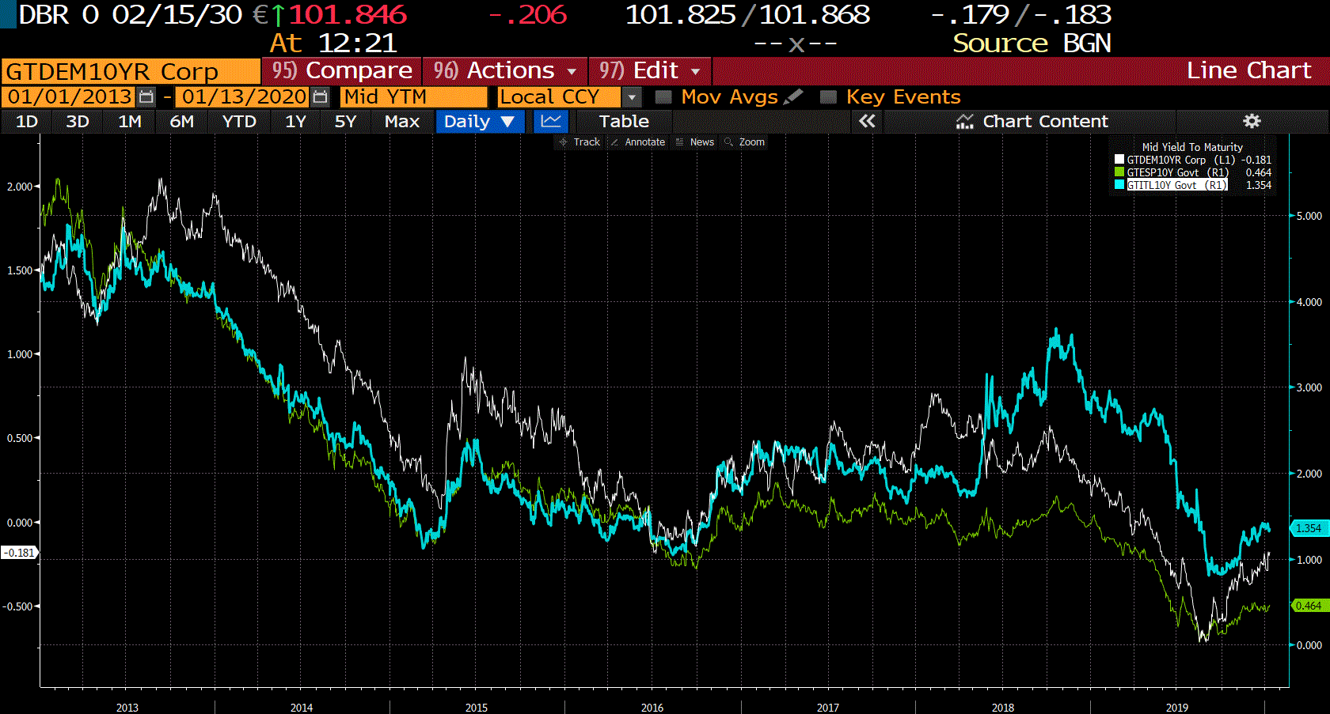
Background (cont.)
Italian and Spanish Bond Yield Spreads over Germany since 2013
Data taken from Bloomberg

Slide 5
Background (cont.)
Government Debt outstanding by country
 | Total Debt in % of GDP | S&P/ Moody’s
Germany | 61.20%* | AAAu/ Aaau
Italy | 137.30%* | BBBu/Baa3u
Spain | 97.90%* | Au/ Baa1
France | 100.50%* | AAu/ Aa2u
Poland | 47.40%* | A/A2
Netherlands | 49.30%* | AAAu/Aaau
Switzerland | 45.66%** | AAAu/Aaau
Source: Bloomberg
*Data as of September 30th 2019
**Data as of 31st December 2017
Updated February 10th 2020
** Data as of February 10th 2020

Slide 6
Eurex 10y Spanish Euro-Bono Futures (FBON) 1/4
On 26 October 2015, Eurex Exchange launched futures on 10-year Spanish government bonds (Bonos y Obligaciones del Estado - BONOs) in order to provide a dedicated instrument suited to the needs of Spanish investors.
The Eurex 10Y Spanish BONO Futures offer market participants a listed futures product which can address the demands of the Spanish market during a time when specific Spanish factors have the potential to influence yield spreads.

Slide 7
Eurex 10y Spanish Euro-Bono Futures (FBON) 2/4
Contract Specifications
 | Eurex Euro-Bono Futures
Contract Standard | Notional long-term debt instrument issued by the Kingdom of Spain with a remaining term of 8.5 to 10.5 years and a six percent coupon (excluding bonds with an original maturity greater than 20 years).
Contract Value | EUR 100,000
Fee and Pricing | EUR 0.20 per contract; TES: EUR 0.30 per contract
Settlement | Spanish government bonds with a remaining term of 8.5 to 10.5 years on the delivery day, a minimum issue amount of EUR 5 billion already 10 exchange days prior to the last trading day of current month and a nominal fixed payment. Such debt securities must be issued by the Kingdom of Spain no later than ten exchange days prior to the Last Trading Day of the current maturity month, otherwise, they shall not be deliverable until the delivery day of the current maturity month.
Price Quotation Tick Size / Value | In percentage of the par value, with two decimal places 0.01% / EUR 10
Contract Months | The three nearest quarterly months of the March, June, September and December cycle.
Delivery Day | Tenth calendar day of the respective quarterly month (Mar, Jun, Sep, and Dec).
Last Trading Day | Two exchange trading days prior to the delivery day of the relevant delivery month. Trading in the maturing delivery month ceases at 12:30 p.m. CET.
Trading Hours | 8:00 a.m. to 7:00 p.m. CET.
Market Making | 9:00 a.m. to 5:30 p.m. CET
CFTC Approval | Available for trading directly via terminals located in the U.S.
Vendor Codes | Bloomberg: KOAA Comdty Reuters: <0#FBON: > CQG: FBON

Slide 8
Eurex 10y Spanish Euro-Bono Futures (FBON) 3/4
Amendment of original term for debt securities for Euro-Bono Futures
On 8 December 2017 the Management Board or Eurex Deutschland and the Executive Board of Eurex Zürich AG took the decision to amend the original term for the underlying debt securities for futures contracts on notional debt securities of the Kingdom of Spain (FBON)
The original term for the Euro-Bono Futures will be amended from 20 years to 15 years for all contracts from and including the September 2018 contract. All contracts prior to September 2018 will maintain an original term of 20 years.

Slide 9
Development in Euro-BONO Futures
Eurex 10y Spanish Euro-Bono Futures (FBON) 4/4
Euro-Bono Future
Total contracts traded since launch: 825,362
ADV 2018: 727 contracts
ADV 2019: 649 contracts
ADV 2020*: 605 contracts
Traded contracts 2018: 173,450
Traded Contracts 2019:165,573
Traded Contracts 2020 YTD*: 90,110
Open Interest end of July 2020*: 3,919
* Data as of July 31st 2020

Slide 10
Opportunities in Trading and Clearing
Eurex Euro-Bono Futures
Hedging
Offer the market an instrument to hedge Spanish debt on-exchange, and remove the basis risk currently present when hedging with BTP Futures.
Spread Opportunities
Offer the market an alternative to cash bonds to trade the respective yield spread between German (or other European sovereign) and Spanish debt.
Basis Trading
Present an opportunity to trade the basis on Spanish debt instruments and therefore complement the Spanish cash market.
Eurex Clearing
Offer reduced counterparty risk and margin off-sets against all other Eurex Fixed Income Futures positions.

Slide 11
Trade Entry Services (TES)
The Eurex Euro-Bono Futures can also be traded outside the order book on a bilateral basis, and subsequently booked to Eurex Clearing through the use of our Trade Entry Services.
Block Trading
Members are able to enter bilaterally agreed off-order book transactions into the trading and clearing system. Registered block trades are then automatically cleared like regular exchange transactions. The block trade entry facility is fully electronic and integrated into members’ processes (the exchange defines a minimum number of contracts for Block trade – see below).
Basis Trading
Basis trading can also be facilitated by the Exchange for Physicals (EFP) and Exchange for Swaps (EFS) functionalities.
Minimum Entry Size for Block Trades
250 contracts. There are no minimum entry size restrictions for EFP or EFS.

Slide 12
Contacts
Sales United Kingdom
Sales Germany / Austria
Sales France / Belgium / Luxembourg
Vassily Pascalis
Deutsche Börse AG
UK Representative Office
11 Westferry Circus, Canary Wharf
London, E14 4HE
United Kingdom
P: +44 (0)20 78 62-72 11
vassily.pascalis@eurexchange.com
Andreas Stadelmaier
Eurex Frankfurt AG
Mergenthalerallee 61
65760 Eschborn
Germany
P: +49 (0)69 2 11-1 38 59
andreas.stadelmaier@eurexchange.com
David Carratero
Deutsche Börse AG
Representative Office France
17, rue de Surène
75008 Paris
France
P: +33 (0)155 2 76-7 68 ebru.ciaravino@eurexchange.com
Sales Switzerland / Italy / Malta
Sales Americas
Sales Asia & Middle East
Francesca Dell’Era
Eurex Global Derivatives AG
Baarerstrasse 135
6300 Zug
Switzerland
P: + 41 (0)43 430 71 23 francesca.dellera@eurexchange.com
Tim Gits
Eurex Frankfurt AG
Chicago Representative Office
233 South Wacker Drive - Suite 2450
Chicago, IL 60606
USA
P: +1 312 5 44-10 58
tim.gits@eurexchange.com
Markus Georgi
Eurex Frankfurt AG
Eurex Representative Office Hong Kong
2904 - 7, 29/F, Man Yee Building, 68 Des Voeux Road Central, Central
Hong Kong
P: +852-25 30-78 20
markus.georgi@eurexchange.com

Slide 13
Appendix 1
Monthly Volume and OI Development in Short- and
Long-Term Euro-BTP Futures
Long-Term Euro-BTP
Total contracts traded since 2017: 104.58 Million
Traded contracts 2018: 29.77 Million
Traded contracts 2019 : 28.37 Million
Traded contracts YTD 2020*: 17.48 Million
Open Interest e/o July 2020*: 386,000
Short-Term Euro-BTP
Total contracts traded since 2017: 57.44 Million
Traded contracts 2018: 17.67 Million
Traded contracts 2019: 17.12 Million
Traded contracts YTD 2020*: 10.47 Million
Open Interest e/o July 2020*: 217,635
* Data as of 31st July 2020

Slide 14
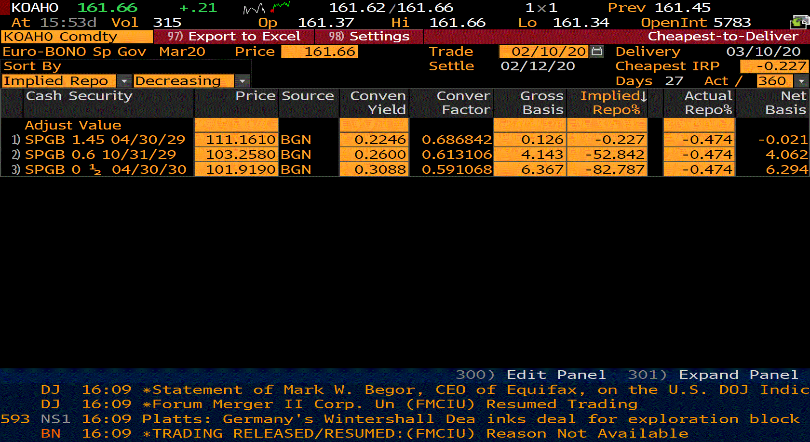
Appendix 2
Delivery Baskets and Conversion Factors
Data taken from Bloomberg

Slide 15
© Eurex 2020
Deutsche Börse AG (DBAG), Clearstream Banking AG (Clearstream), Eurex Frankfurt AG, Eurex Clearing AG (Eurex Clearing) and Eurex Repo GmbH (Eurex Repo) are corporate entities and are registered under German law. Eurex Zürich AG is a corporate entity and is registered under Swiss law. Clearstream Banking S.A. is a corporate entity and is registered under Luxembourg law. U.S. Exchange Holdings, Inc. and International Securities Exchange Holdings, Inc. (ISE) are corporate entities and are registered under U.S. American law. Eurex Frankfurt AG (Eurex) is the administrating and operating institution of Eurex Deutschland. Eurex Deutschland and Eurex Zürich AG are in the following referred to as the “Eurex Exchanges”.
All intellectual property, proprietary and other rights and interests in this publication and the subject matter hereof (other than certain trademarks and service marks listed below) are owned by DBAG and its affiliates and subsidiaries including, without limitation, all patent, registered design, copyright, trademark and service mark rights. While reasonable care has been taken in the preparation of this publication to provide details that are accurate and not misleading at the time of publication DBAG, Clearstream, Eurex, Eurex Clearing, Eurex Repo as well as the Eurex Exchanges and their respective servants and agents (a) do not make any representations or warranties regarding the information contained herein, whether express or implied, including without limitation any implied warranty of merchantability or fitness for a particular purpose or any warranty with respect to the accuracy, correctness, quality, completeness or timeliness of such information, and (b) shall not be responsible or liable for any third party’s use of any information contained herein under any circumstances, including, without limitation, in connection with actual trading or otherwise or for any errors or omissions contained in this publication.
This publication is published for information purposes only and shall not constitute investment advice respectively does not constitute an offer, solicitation or recommendation to acquire or dispose of any investment or to engage in any other transaction. This publication is not intended for solicitation purposes but only for use as general information. All descriptions, examples and calculations contained in this publication are for illustrative purposes only.
Eurex and Eurex Clearing offer services directly to members of the Eurex exchanges respectively to Clearing Members of Eurex Clearing. Those who desire to trade any products available on the Eurex market or who desire to offer and sell any such products to others or who desire to possess a clearing license of Eurex Clearing in order to participate in the clearing process provided by Eurex Clearing, should consider legal and regulatory requirements of those jurisdictions relevant to them, as well as the risks associated with such products, before doing so.
Only Eurex derivatives that are CFTC-approved may be traded via direct access in the United States or by United States persons. A complete, up-to-date list of Eurex derivatives that are CFTC-approved is available at: http://www.eurexchange.com/exchange-en/products/eurex-derivatives-us. In addition, Eurex representatives and participants may familiarise U.S. Qualified Institutional Buyers (QIBs) and broker-dealers with certain eligible Eurex equity options and equity index options pursuant to the terms of the SEC’s July 1, 2013 Class No-Action Relief. A complete, up-to-date list of Eurex options that are eligible under the SEC Class No-Action Relief is available at: http://www.eurexchange.com/exchange-en/products/eurex-derivatives-us/eurex-options-in-the-us-for-eligible-customers. Lastly, U.S. QIBs and broker-dealers trading on behalf of QIBs may trade certain single-security futures and narrow-based security index futures subject to terms and conditions of the SEC’s Exchange Act Release No. 60,194 (June 30, 2009), 74 Fed. Reg. 32,200 (July 7, 2009) and the CFTC’s Division of Clearing and Intermediary Oversight Advisory Concerning the Offer and Sale of Foreign Security Futures Products to Customers Located in the United States (June 8, 2010).
Trademarks and Service Marks
Buxl®, DAX®, DivDAX®, eb.rexx®, Eurex®, Eurex Bonds®, Eurex Repo®, Eurex Strategy WizardSM, Euro GC Pooling®, FDAX®, FWB®, GC Pooling®,,GCPI®, MDAX®, ODAX®, SDAX®, TecDAX®, USD GC Pooling®, VDAX®, VDAX-NEW® and Xetra® are registered trademarks of DBAG. Phelix Base® and Phelix Peak® are registered trademarks of European Energy Exchange AG (EEX). All MSCI indexes are service marks and the exclusive property of MSCI Barra. RDX® is a registered trademark of Vienna Stock Exchange AG.
IPD® UK Annual All Property Index is a registered trademark of Investment Property Databank Ltd. IPD and has been licensed for the use by Eurex for derivatives. SLI®, SMI® and SMIM® are registered trademarks of SIX Swiss Exchange AG.
The STOXX® indexes, the data included therein and the trademarks used in the index names are the intellectual property of STOXX Limited and/or its licensors Eurex derivatives based on the STOXX® indexes are in no way sponsored, endorsed, sold or promoted by STOXX and its licensors and neither STOXX nor its licensors shall have any liability with respect thereto.
Dow Jones, Dow Jones Global Titans 50 IndexSM and Dow Jones Sector Titans IndexesSM are service marks of Dow Jones & Company, Inc. Dow Jones-UBS Commodity IndexSM and any related sub-indexes are service marks of Dow Jones & Company, Inc. and UBS AG. All derivatives based on these indexes are not sponsored, endorsed, sold or promoted by Dow Jones & Company, Inc. or UBS AG, and neither party makes any representation regarding the advisability of trading or of investing in such products.
All references to London Gold and Silver Fixing prices are used with the permission of The London Gold Market Fixing Limited as well as The London Silver Market Fixing Limited, which for the avoidance of doubt has no involvement with and accepts no responsibility whatsoever for the underlying product to which the Fixing prices may be referenced.
PCS® and Property Claim Services® are registered trademarks of ISO Services, Inc.
Korea Exchange, KRX, KOSPI and KOSPI 200 are registered trademarks of Korea Exchange Inc.
BSE and SENSEX are trademarks/service marks of Bombay Stock Exchange (BSE) and all rights accruing from the same, statutory or otherwise, wholly vest with BSE. Any violation of the above would constitute an offence under the laws of India and international treaties governing the same.
The names of other companies and third party products may be trademarks or service marks of their respective owners.

